Slide 1
Predicting sentiment in Expeditie Robinson
Students: Kacper Janczyk, Simona Dimitrova, Wesley van Gaalen, Jakub Cyba, Matache Vlad Bogdan Narcis
Lecturers: Alician Noyan, Myrthe Buckens, Dean van Aswegen

Slide 2
Project Scope & Datasets

Slide 3



Project Scope
Project Scope & Datasets
Define objective
Prepare Data
Train models
Iterate
Notes:
Emotion detection is one of the most important application of NLP, allowing for improvement in decision-making process and better understanding of consumers' emotions. With that in mind, Banijay Benelux, a prominent media company, and 3Rivers, a leading media consultancy firm, have collaborated to explore the practical implications of emotion detection. Our project goal is to automate emotion labeling for the TV series Expeditie Robinson, also known as Survivor, which is one of the flagship programs of Banijay Benelux. We plan to achieve this by developing an extensive emotion classification model that can accurately identify Ekman's six key emotions within each segment of the show, using existing emotion-tagged data. Our goal is to develop a pipeline that utilizes speech-to-text technology to extract and categorize emotions. This will provide the client with a deeper comprehension of viewer engagement patterns.

Slide 4
Training Data
Project Scope & Datasets
Datasets
Affective text
Carer
Fairytails
Meld Masters
Daily Dialog
Emotion Detection Master
Goemotions
ChatGPT
Survivor
LIAR
anger(77918)
fear(59695)
surprise(35989)
disgust(5550)
Size
happiness(224422)
sadness(143454)
Neutral(21237)
Notes:
The training data serves as a core to our model training process. We were provided with an overall amount of 9 different datasets, which contain sentences from various sources, such as Reddit, Twitter, TV show "Friends" and fairytales. We also used an additional dataset, called "LIAR" which contains 12.8K manually labelled short statements used for fake news detection.

Slide 5


Test Data
Project Scope & Datasets
Students write sentences
Download the kaggle csv
Use the ground truth to monitor the F1
Iterate
Manually label ground truth
Notes:
Iterate – create model, check precision, recall, F1 and suport
We assessed the effectiveness of our models by testing them on a dataset obtained from Kaggle. This dataset contains 1436 sentences, each labelled with a sequence ID and an integer value, along with the text itself. Our goal was to predict emotions based on these sentences.
To evaluate the models' performance, we utilised the F1 score metric. Detailed discussion on this evaluation will be provided.
Finally, to fulfil the project's use case, we received "Expeditie Robinson" data from our client, Banijay Benelux. This dataset comprises 17 video files. Our objective was to extract the audio from these files, transcribe it, translate it from Dutch to English, and segment it based on the start and end times of each segment. This crucial information was provided in a CSV file containing three key columns: "Start Time," "End Time," and "Emotions."

Slide 6
Exploratory Data Analysis

Slide 7
Pre-Processing
Step 1
Download the datasets
Step 2
Clean the data and map emotions
Step 3
Merge the datasets and save to CSV

Slide 8
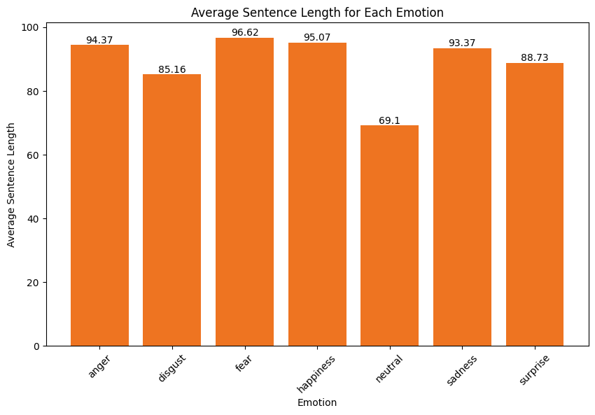
Pre-Processing
Exploratory Data Analysis
Emotion | Frequency
happiness | 224422
sadness | 143454
anger | 77918
fear | 59695
surprise | 35989
neutral | 21237
disgust | 5550

Slide 9
9

Slide 10
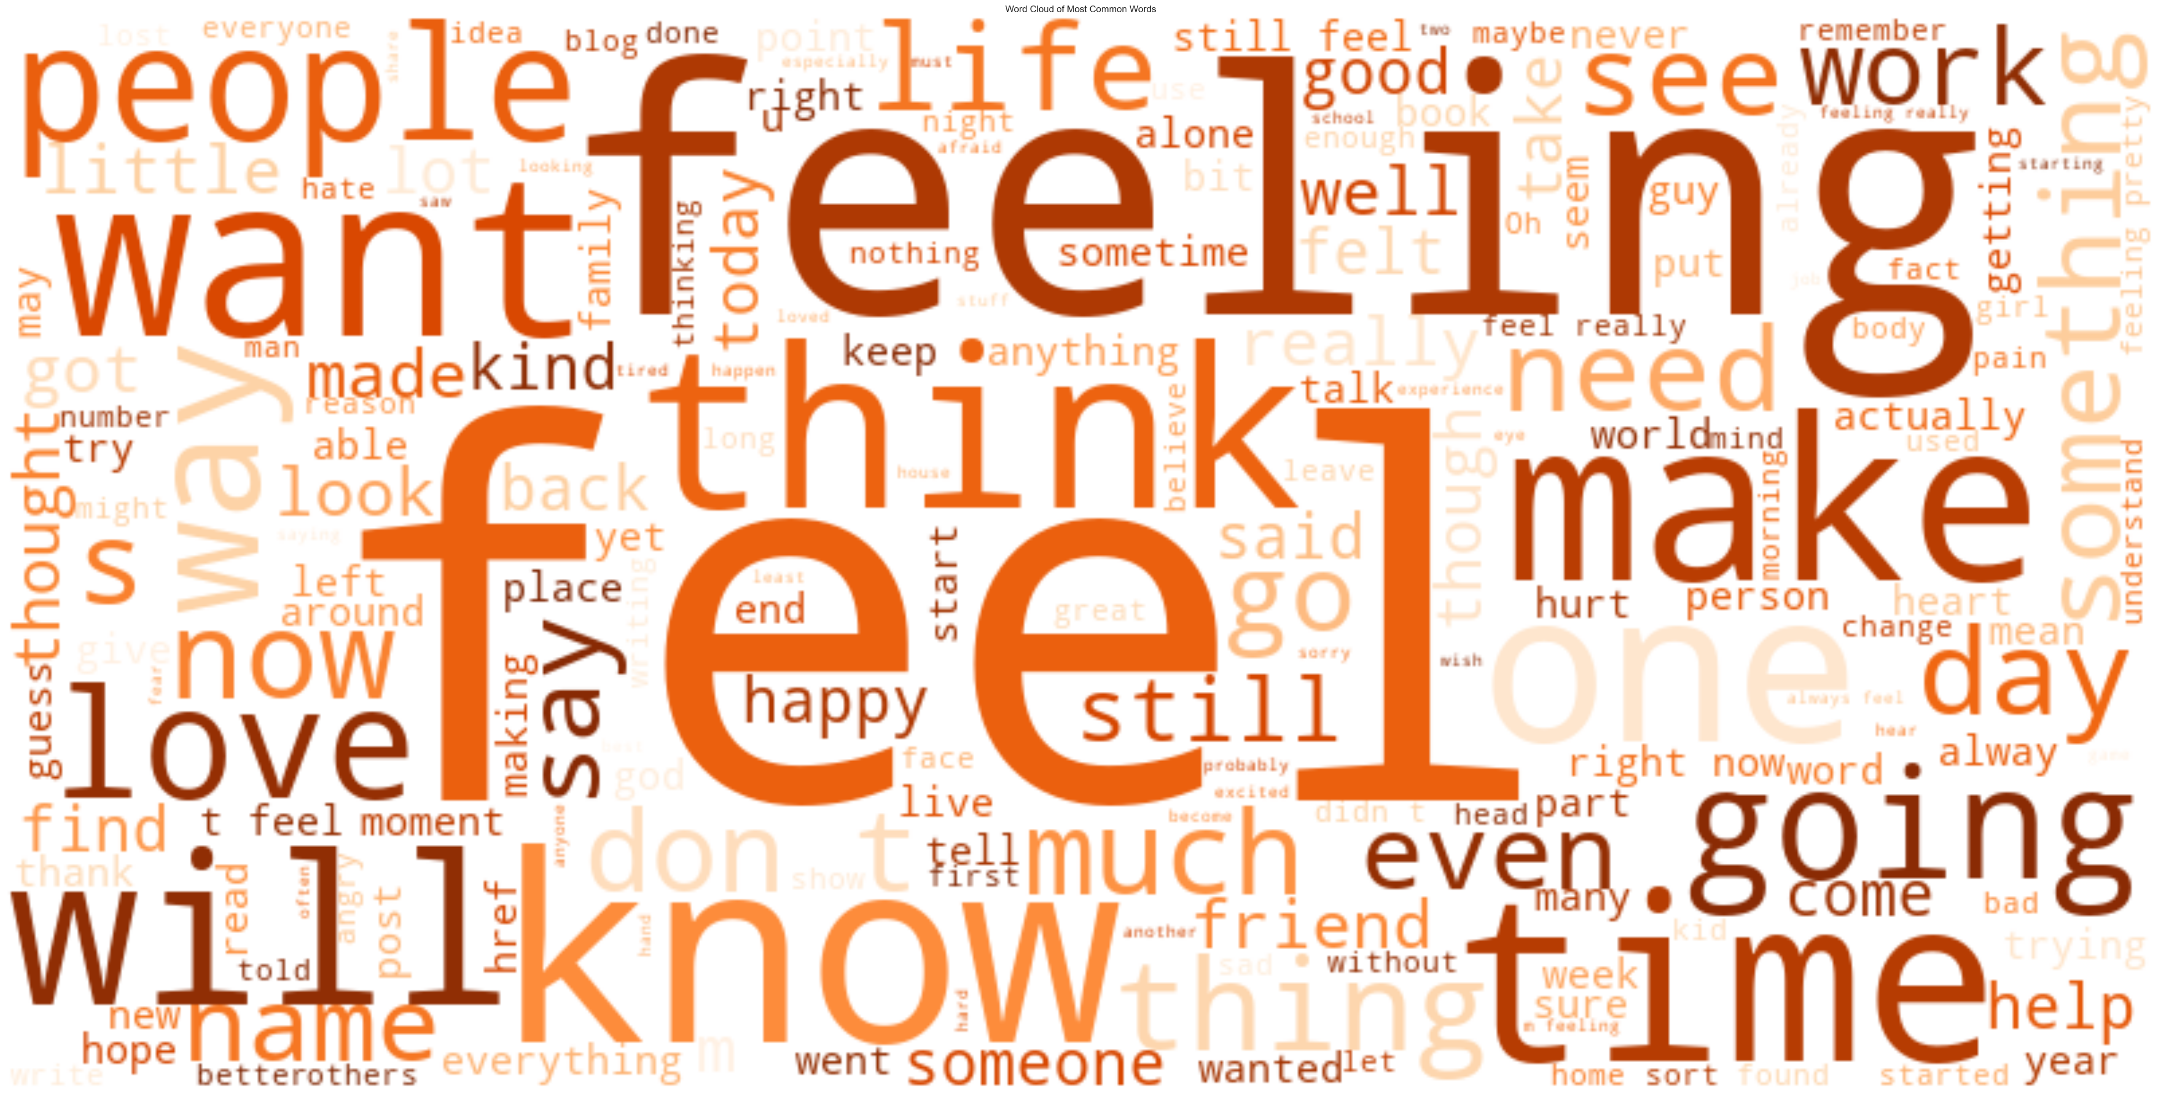

Slide 11
Model development

Slide 12
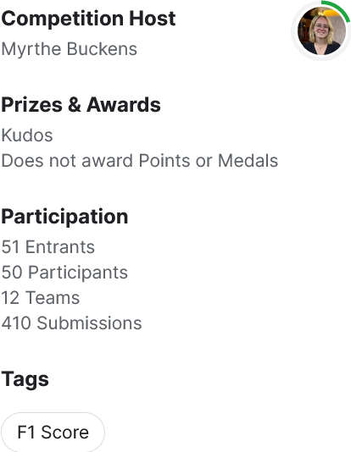
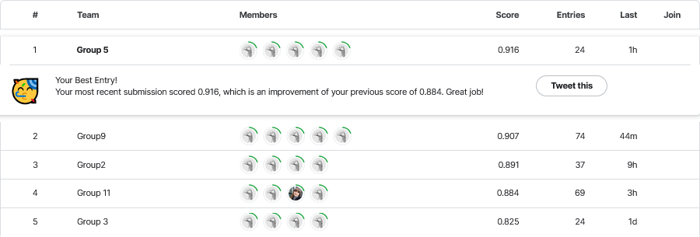
Kaggle Competition
Model Development

Slide 13
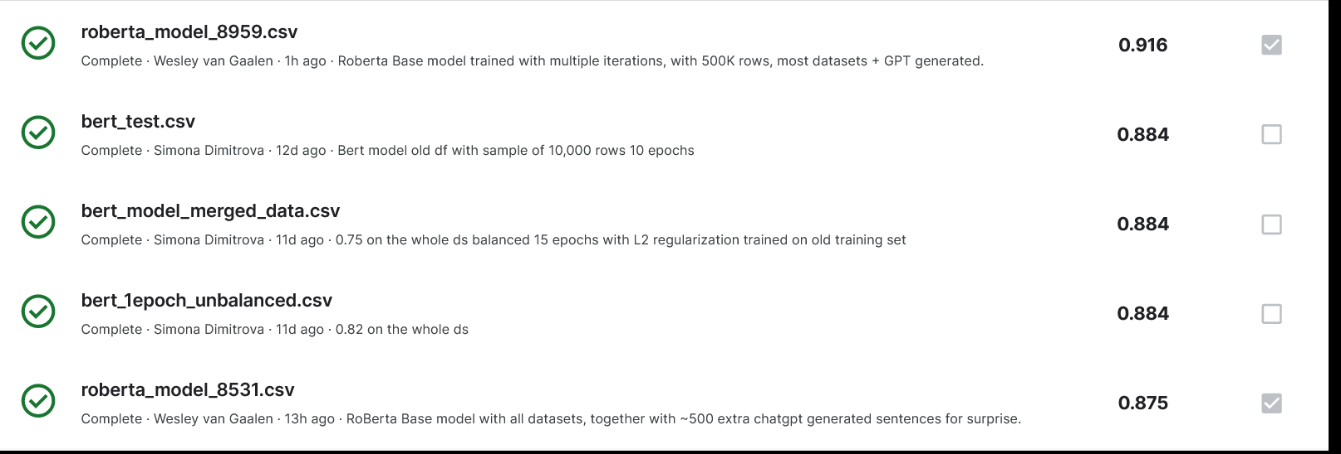
Kaggle Competition
Model Development

Slide 14
Kaggle Competition
Model Development
Model | Weighted F1 (Public Score) | Experimental Configurations
RoBERTa_base_uncased_model | 0.916 | Unbalanced emotions
RoBERTa base uncased model | 0.859 | Balanced emotions
RoBERTa large uncased model | 0.851 | Unbalanced emotions
BERT base uncased model | 0.840 | Unbalanced emotions + data augmentation
Simple NN (custom word embedding) model | 0.650 | Unbalanced emotions

Slide 15
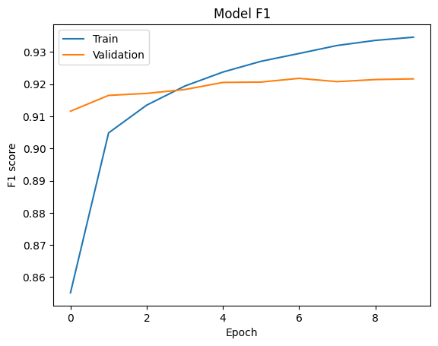
Simple NN (Neural Network)
1st Iteration
Simple Neural Network
Unbalanced emotions
F1 on test set: 0.650
Notes:
Tokenization and Padding: The text data is tokenized into word indices using a tokenizer. Then, sequences are padded to ensure uniform length, which is essential for inputting data into neural networks since they typically require fixed-size inputs.
Label Encoding: The emotion labels are encoded into numerical values using label encoding. This transforms categorical data into a format that the model can understand.
One-Hot Encoding: One-hot encoding is applied to the numerical labels. This converts each integer label into a binary vector, where each element represents a different emotion class. This is commonly used for multi-class classification tasks to represent categorical variables.
Embedding Layer: This layer converts the tokenized input sequences into dense vectors of fixed size. It maps each word index to a dense vector representation, which is learned during the training process.
Flatten Layer: This layer flattens the output from the embedding layer into a 1D array, which is then passed to the subsequent fully connected layers.
Dense Layers: Two dense layers are added:
The first dense layer consists of 128 units with ReLU activation, allowing the model to learn complex patterns in the data.
Dropout regularization is applied to prevent overfitting by randomly setting a fraction of input units to zero during training.
Batch normalization helps stabilize the learning process by normalizing the activations of the previous layer at each batch.
Output Layer: The final dense layer uses softmax activation to output probabilities for each class. The number of units in this layer equals the number of unique emotion classes in the dataset.
#Simple model
model = Sequential()
model.add(Embedding(input_dim=len(tokenizer.word_index) + 1,
output_dim=6, input_length=max_length))
model.add(Flatten())
model.add(Dense(units=128, activation="relu"))
model.add(Dropout(0.5))
model.add(BatchNormalization())
model.add(Dense(units=len(one_hot_labels[0]), activation="softmax"))

Slide 16
BERT model
2nd Iteration
BERT base-uncased (Bidirectional Encoder Representations Transformer)
Balanced emotions
F1 on test set: 0.789

Slide 17
BERT model
3rd Iteration
BERT base-uncased (Bidirectional Encoder Representations Transformer)
Unbalanced emotions
Augmented Data
F1 on test set: 0.843
Notes:
Unbalanced data – Datases not equally distributed
Augmented data – more data was added Data was translated into French from English and then back again
Dataset distribution – 547028 rows of which most is happiness and least is disgust

Slide 18
Llama 2 model 3rd Iteration
7B, 14B, 70B Parameters
Balanced emotions

Slide 19
RoBERTa
Best Performing Model
RoBERTa base-uncased (Bidirectional Encoder Representations Transformer)
Balanced emotions
F1 on test set: 0.91
Notes:
Robustly optimized BERT Approach

Slide 20
Why RoBERTa?
Model Development
BERT
Better on small datasets
Less parameters
RoBERTa
Better text comprehension
Faster to train
Notes:
Is considerd to be the robust version of BERT
Roberta is trained on bigger dataset than BERT
Understands language patterns better
Roberta – repeatedly masking words, improving a straightforward learning process
BERT - engages in a guessing game with some of the words it come across

Slide 21
Error Analysis

Slide 22
Evaluation Metrices
Precision
Recall
F1

Slide 23
Classification report
Model Development
Emotion | Precision | Recall | F1-Score | Support
Anger | 0.77 | 0.91 | 0.83 | 253
Disgust | 0.91 | 0.83 | 0.87 | 199
Fear | 0.80 | 0.93 | 0.86 | 215
Happiness | 0.80 | 0.97 | 0.87 | 263
Sadness | 0.93 | 0.76 | 0.83 | 289
Surprise | 0.92 | 0.65 | 0.76 | 217
Total F1 Score: 0.849

Slide 24
Classification report
Model Development
Emotion | Precision | Recall | F1-Score | Support
Anger | 0.77 | 0.91 | 0.83 | 253
Disgust | 0.91 | 0.83 | 0.87 | 199
Fear | 0.80 | 0.93 | 0.86 | 215
Happiness | 0.80 | 0.97 | 0.87 | 263
Sadness | 0.93 | 0.76 | 0.83 | 289
Surprise | 0.92 | 0.65 | 0.76 | 217
Total F1 Score: 0.849

Slide 25
Translation back augmentation
Surprise
English > French
French > English
Original: I am feeling very surprised.​
Back-translated: I feel very surprised.

Slide 26
Chat GPT data generation
Generate sentences with surprise emotion
Example: Her jaw dropped as she took in the unexpected turn of events

Slide 27
Classification report
Model Development
Emotion | Precision | Recall | F1-Score | Support
Anger | 0.77 | 0.91 | 0.83 | 253
Disgust | 0.91 | 0.83 | 0.87 | 199
Fear | 0.80 | 0.93 | 0.86 | 215
Happiness | 0.80 | 0.97 | 0.87 | 263
Sadness | 0.93 | 0.76 | 0.83 | 289
Surprise | 0.92 | 0.65 | 0.76 | 217
Total F1 Score: 0.849

Slide 28
Classification report
Model Development
Emotion | Precision | Recall | F1-Score | Support
Anger | 0.79 | 0.89 | 0.84 | 253
Disgust | 0.90 | 0.81 | 0.85 | 199
Fear | 0.87 | 0.88 | 0.88 | 215
Happiness | 0.86 | 0.94 | 0.89 | 263
Sadness | 0.87 | 0.77 | 0.82 | 289
Surprise | 0.85 | 0.84 | 0.85 | 217
Total F1 Score: 0.853

Slide 29
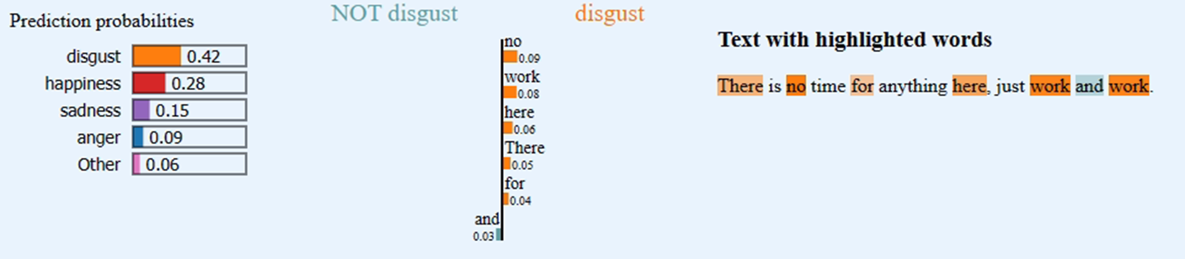
Error Analysis
Predicted: Disgust
Actual: Sad

Slide 30
Pipeline

Slide 31



Pipeline
Input: Survivor episode (.mov)
ASR and translate speech
Predict sentiment
Get the 3 most occurring emotions per segment
Output: dataset with segments and emotions
segment | emotions | Dominating emotions
The Green Team Divided over three different teams, the expedition members spent their first night on an uninhabited island. The Green Team, led by London, slept on the lovely, peaceful and rich Camp West. The other teams left for Camp North and Camp South. And there they have to do with the basic necessities. Like usual, the teams withdraw to fight for the first immunity test. But this expedition has a somewhat unusual setup. And so, before it's over, there is a special surprise. Walf and Walf. | fear, happiness, surprise, disgust, anger, surprise, happiness, anger | happiness, surprise, anger

Slide 32
Thank you!
Time for questions

Slide 33
Appendix

Slide 34
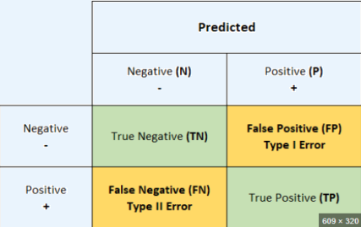
Confusion Matrix
Actual

Slide 35
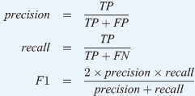
Formulas

Slide 36
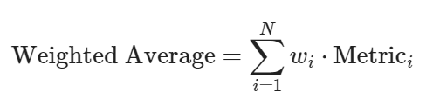
Weighted F1 Score
Takes into consideration the Support number and assigns each class a weight.

Slide 37
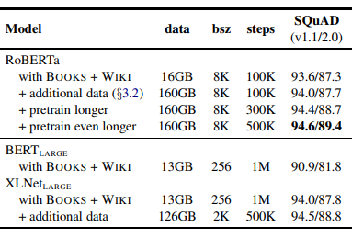
RoBERTa
https://arxiv.org/abs/1907.11692

